Slide 1

Driving patient safety National Standard Demographic Dataset for use in health and social care settings in Ireland
Barbara Foley, PhD
Tracy O’Carroll
Health Information and Quality Authority (HIQA)

Slide 2

Overview
Background - Health Information and Quality Authority (HIQA)
Health Information Directorate - current projects
National Standard Demographic dataset and guidance
Purpose
Methodology
Summary of dataset and guidance

Slide 3

Remit of HIQA
To drive continuous improvements in the quality and safety of health and social care in Ireland.
Notes:
Not just a regulator for when things go wrong but promote health and social services excellence by delivering a structured programme aimed at identifying and sharing good practice, building capacity and capability

Slide 4
Background
Health Act 2007, establishment 15 May 2007
Independent - reporting to Minister for Health
Work with stakeholders, including patients
Person-centred ethos of “working with” not “doing to”
HQ in Cork; regional office in Dublin
Regulatory directorate (health and social services)
Safety, Quality Improvement directorate
Health Technology Assessment
Health Information
Notes:
Working with stakeholders examples:
Patient reps on all advisory committees
Report as much as possible free from jargon and written in simple English
Guides to help the public and raise awareness – Checklist of what to look for in a nursing home – advise on what questions to ask, arranging a visit.
Recently published booklet on Information Governance – raising awareness of patient rights around health information (privacy and confidentiality)

Slide 5

What is HIQA’s role?
Setting Standards
Safer Better Care (healthcare)
Residential care of older people
Protection and welfare of children
Residential services for people with disabilities
Monitoring Quality and Safety in Healthcare
Inspecting Social Services
Health Technology Assessment
Health Information
Notes:
CEO – Dr Tracey Cooper
Board – Mr. Pat McGrath
HIQA is organised into Directorates
Currently reviewing its structures from directorates to a cross directorate approach

Slide 6

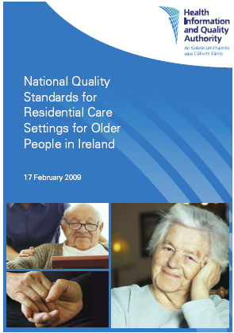


Setting Standards
Healthcare
Social care
Health Information
Notes:
Setting Standards
Symptomatic Breast Disease
Healthcare associated Infections
Residential care of older people
National Standards for Children in Residential Services

Slide 7
Health Information function
Develop the standards for the collection and sharing of information across the health and social services
Develop standards for interoperability of information systems
Identify gaps in the collection and sharing of information
Collaborate with key stakeholders
Evaluate, interpret and publish available information on our health and social care services and population health
Notes:
HI Directorate
Jane Grimson (Director)
14 staff – based in both cork and Dublin
various background – nurses, doctors, scientific/technical staff

Slide 8



Health Information projects
National data collections
National Catalogue of all health and social care data collections in Ireland
Guiding Principles for national data collections
Information governance
Data quality
Identifiers

Slide 9
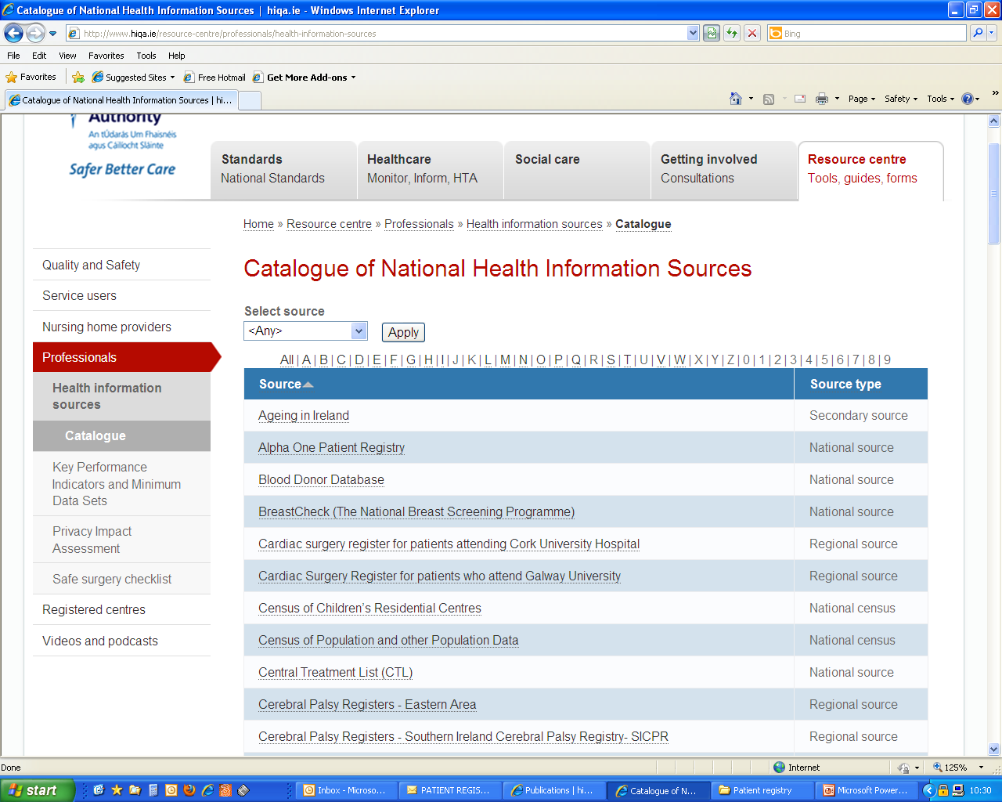

Slide 10
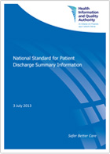
Health Information Standards
General Practice Messaging standard Version 2.0
National Standard for Patient Discharge summary
National Standard Demographic Dataset and Guidance

Slide 11

GP referral dataset (March 2011)
Recommendations on patient referrals from general practice to outpatient and radiology services
National standard template for patient referral information

